Slide 1
Urban wetlands make cities liveable
Ramsar Convention on Wetlands

Slide 2
World Wetlands Day 2018 – get involved!
Celebrated every 2 February to mark the adoption of the Ramsar Convention in Iran in 1971
Wetlands for a sustainable urban future, the theme for 2018 highlights the important role of urban wetlands in making cities liveable
Ways you can participate:
Organize an event to educate others about the importance of urban wetlands
Register and upload your event to www.worldwetlandsday.org
Share the information materials on social media to raise public awareness about wetlands.

Slide 3
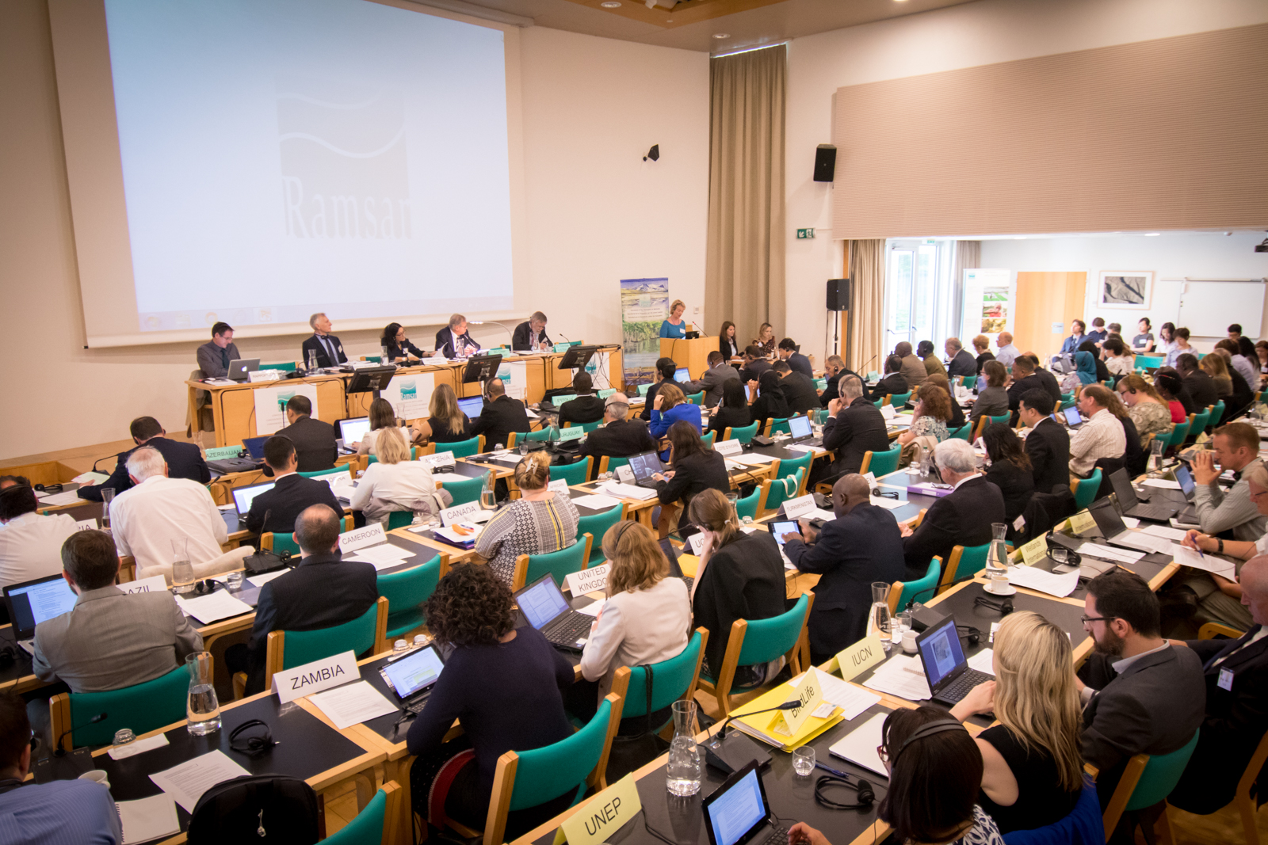
Ramsar Convention on Wetlands: Working to reverse wetland loss and degradation
First global environmental treaty; only one to focus on a single ecosystem
Adopted in Ramsar, Iran in 1971
Parties commit to designating protected wetland Ramsar Sites, wise use of wetlands and cooperation on transboundary issues
Number of Contracting Parties: 169
Number of Ramsar Sites: 2,284
Total surface area of Ramsar Sites: 220,673,362 ha (slightly larger than Mexico)
www.ramsar.org/sites-countries/the-ramsar-sites
Meeting Standing Committee 53, Gland, Switzerland
Photo: Ramsar Convention

Slide 4
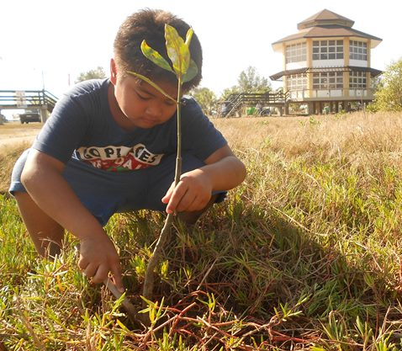
Ramsar Convention on Wetlands: Committed to sustainable development
Ramsar Convention’s 4th Strategic Plan contributes to 16 different SDGs; many relating to urban development:
Goal 6: Ensure water & sanitation for all
Goal 9: Build resilient infrastructure
Goal 11: Making cities inclusive, safe, resilient and sustainable
Goal 12: Ensure sustainable consumption and production patterns
Goal 13: Combat climate change
Goal 15: Protect, restore and promote sustainable use of terrestrial ecosystems
Mangrove planting, Balanga City Wetland Park, Philippines
Photo: Ramsar Convention

Slide 5
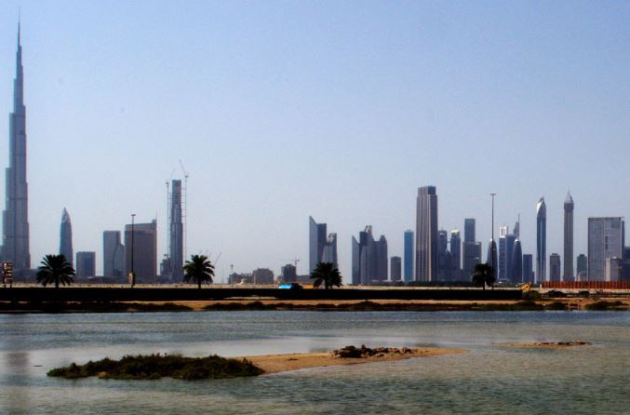
Ramsar Convention on Wetlands Wetland City Accreditation Scheme
Voluntary accreditation scheme for cities
Stem loss of urban and peri-urban wetlands due to growing urbanization
Decision of Contracting Parties Resolution XII.10 adopted in 2015
Encourages cities to take deliberate actions to conserve, restore and wisely use urban wetlands
First eligible cities to receive a certification in 2018 accrediting them as a wetland city.
Wetland City Accreditation winners will be announced at the 2018 Ramsar Conference of Parties (COP) in Dubai.
Photo: ramsar.org

Slide 6
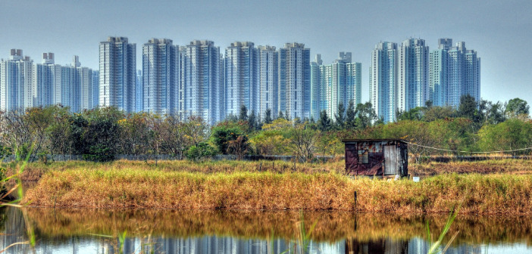
Wetlands and cities: A long symbiotic relationship
Earliest cities sprung up in the fertile Tigris & Euphrates floodplains
Benefits of agriculture, water supply, transport
Wetland: a land area that is flooded with water, either permanently or seasonally
Types of wetlands include:
Rivers & floodplains, marshes, peatlands
Mangroves, salt marshes, estuaries, coral reefs
Urban and peri-urban wetlands:
Any wetlands found in or around cities, their suburbs and outlying areas
Wetlands in Kowloon, Hong Kong
Photo: urbanwetlands.org

Slide 7
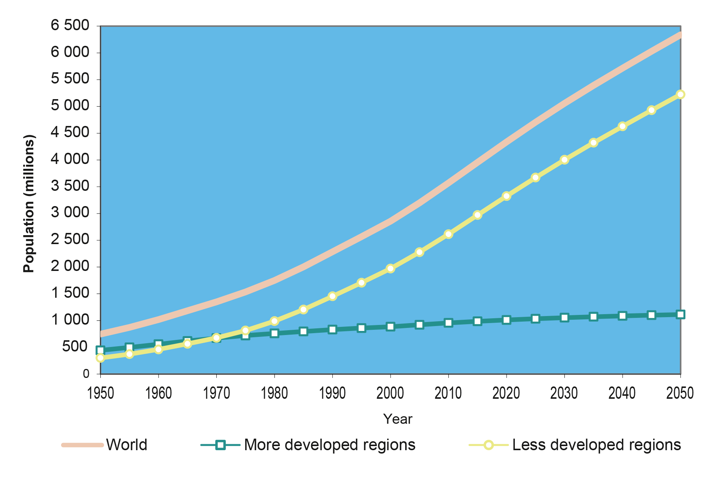
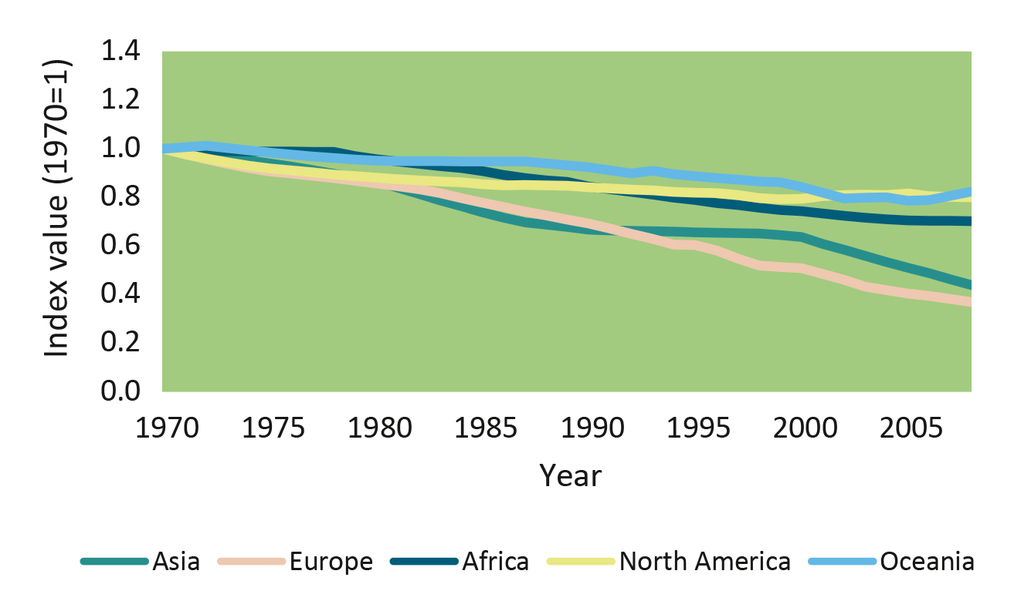
Wetlands and cities: On opposite trajectories
While cities are growing . . .
50% about 4 billion people live in urban areas today and by 2050 that number will reach 66%
World urban population, 1970-2016
Wetlands are disappearing.
More than 64% of the world’s wetlands have been lost since 1900.
Wetland Extent Index 1970-2008
Estimated and projected urban populations of the world, the more developed regions and the less developed regions, 1950-2050

Slide 8
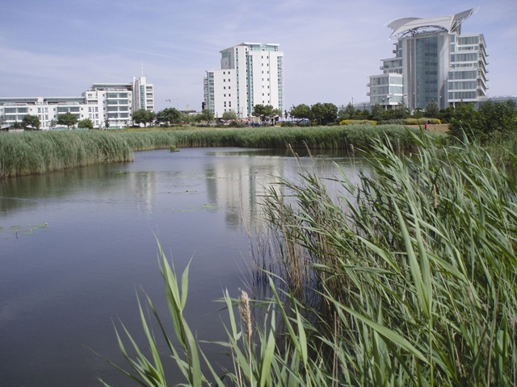
Wetlands and cities: the challenge Retain & restore wetlands to make future cities liveable!
The sustainability balancing act for urban planners:
Provide land for building, and basic services like water and waste removal while also
Preserving and restoring natural resources – including wetlands – for the long term
Urban population rising 2.4% a year
number of mega-cities (more than 10 million inhabitants) will jump from 31 to 41 by 2030
Huge opportunity: use urban wetlands to make cities more liveable.
Cardiff Wetlands, Wales, United Kingdom
Photo: Wikimedia Commons

Slide 9
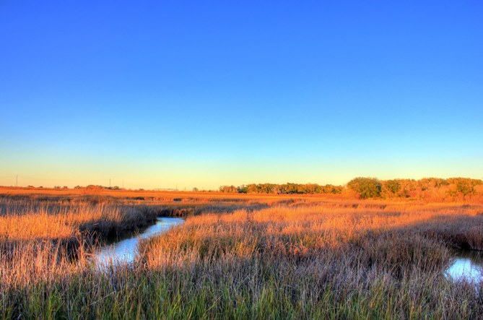
Urban wetlands make cities liveable by: Reducing flooding
Wetlands act as giant sponges to lessen the impact of flooding.
Rivers, ponds, lakes and marshes soak up and store heavy rainfall, releasing it gradually over time
Saltmarshes and mangroves act as a buffer against storm surges.
One kilometer of intact mangrove forest can reduce a storm floodsurge by up to 50cm
Example: Hurricane Sandy
Wetlands avoided an estimated $625 million in damage when this storm hit densely populated US east coast in 2012
San Jacinto Marsh near Houston, Texas, USA
Photo: goofreeephotos.com

Slide 10
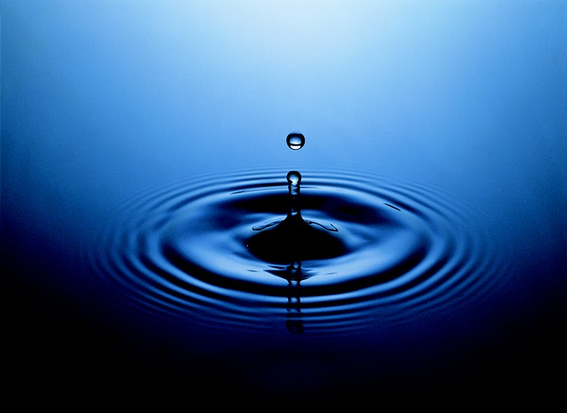
Urban wetlands make cities liveable by: Improving water quality
Only 3% of water on the planet is fresh; most of this is frozen. Water is a scarce resource!
Deep groundwater aquifers provide half of all drinking water, including water supply to:
2 billion people in Asia
380 million people in Europe
Wetlands on the surface filter the water that seeps into these aquifers from above, helping to replenish the water supply.
Photo: Pixabay.com

Slide 11
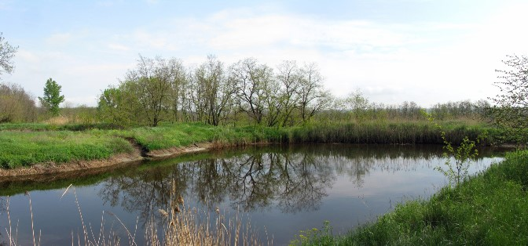
Urban wetlands make cities liveable by: Filtering and treating waste
Silt-rich soil and abundant plants in wetlands act as filter for
Harmful toxins,
Agricultural pesticides and
Industrial waste
Urban wetlands can also treat sewage cost-effectively
Example: Nakivubo Swamp, Kampala, Uganda
550 hectare urban wetland stretching from city’s industrial center to Lake Victoria
Filters water and reduces contaminants
Water treatment worth $US2 million per year
Wetland water treatment pond in Melitopol,Ukraine Photo: Wikimedia Commons

Slide 12
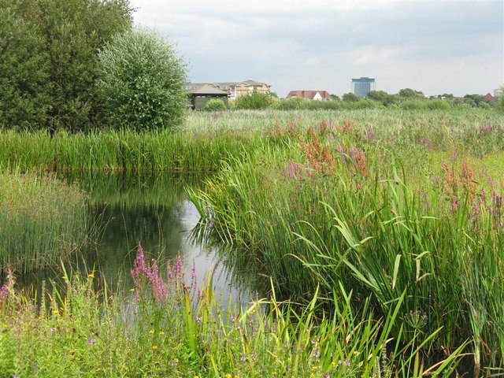
Urban wetlands make cities liveable by: Improving local air quality
Wetlands radiate moist air thanks to their high water levels and lush plant life.
They naturally cool the air in the local surroundings.
Offer relief in both tropical cities and in climates where the air is extremely dry
Restored wetland landscape at London Wetland Centre
Photo: Wikimedia Commons

Slide 13
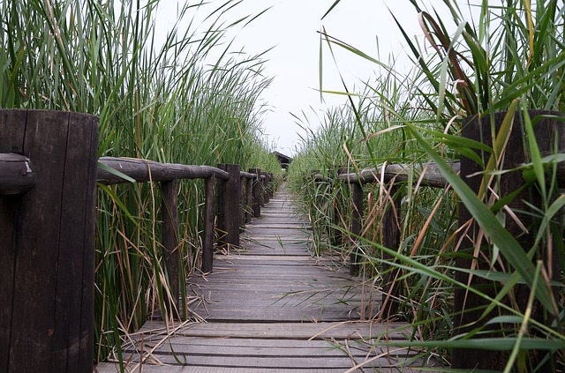
Urban wetlands make cities liveable by: Providing green space for relaxation
Urban wetlands offer stressed city dwellers the chance to decompress and encounter diverse plant and animal life.
Studies confirm that interacting with nature improves our health.
Example: Huangshan City, China; city of 1.4 million people
7.5km bank of the Xin’an River in city center restored to natural wetland
Provides natural flood control plus
New green belt with park, botanical gardens and housing
Chen Bridge, Henan, China
Photo: Pixabay.com

Slide 14
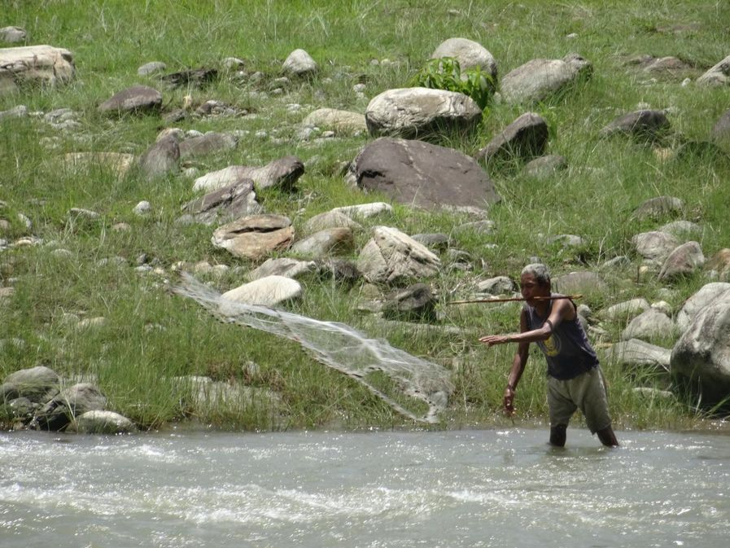
Urban wetlands make cities liveable by: Providing jobs to local residents
Many types of fish spawn and breed in wetlands, making them popular fishing grounds.
660 million people depend on fishing and aquaculture for their livelihoods worldwide
Wetlands produce valuable goods to gather and process, often benefiting the poor.
Reeds and grasses for weaving
Wood for building
Medicinal plants and fruits
Wetlands attract tourism, also a major source of employment.
Wetland fisherman, Nepal
Photo: Ramsar Convention, WWD Photo Contest

Slide 15
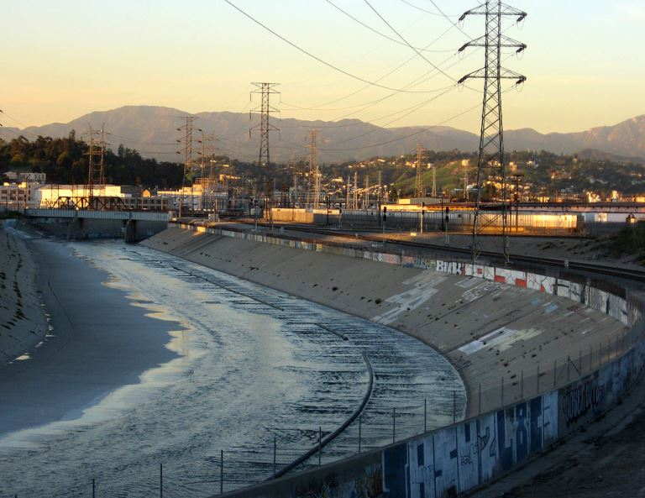
Mismanaging urban wetlands: Makes cities prone to disasters
At least 64% of wetlands have disappeared since 1900.
Canalizing rivers can make floods more powerful.
Dumping rubbish ruins natural green spaces.
Clearing mangroves and mining coral reefs can expose city coastlines to storms.
Burning or draining peatlands releases CO2.
Los Angeles River, California, USA
Photo: Wikipedia

Slide 16
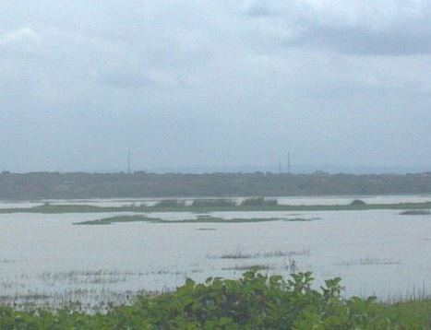
Treating urban wetlands right: Integrate wetlands into policy and planning
Plan for wetlands as a natural part of water infrastructure.
Adopt policies to limit degradation, promote efficient water use.
Example: Accra, Ghana
Fast growth threatening local wetlands
City responded with integrated measures
Enforcing building regulations
Creating green belts to control sprawl
Education programs for local residents
Designating two local wetlands as Ramsar Sites
Sakumono Lagoon Ramsar Site in greater Accra, Ghana
Photo: Wikimedia Commons

Slide 17
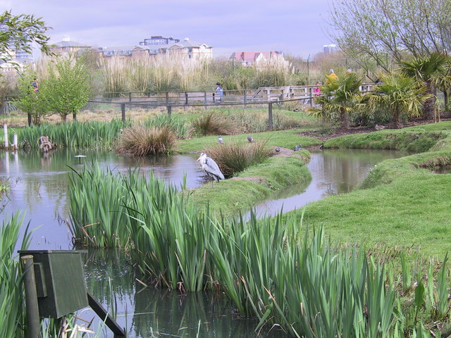
Treating urban wetlands right: Preserve and restore urban wetlands
Many cities are located in coastal areas and river floodplains where wetlands were once widespread.
Actively restore wetlands – and their benefits.
Example: London Wetland Centre
40-hectare restored wetland on site of four old water reservoirs
Now home to wide range of wildlife including 180 bird species
Visitor Centre for wetland education
Grey heron at London Wetland Centre
Photo: Wikimedia Commons

Slide 18
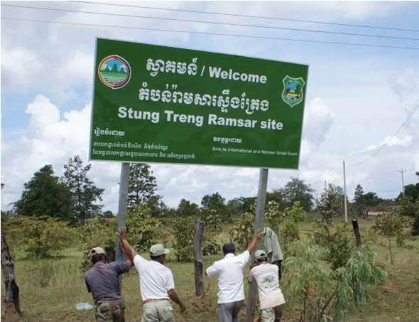
Treating urban wetlands right: Involve local residents in planning
People often depend on local wetlands for their living; it’s important to understand their views and get their buy-in
Example: Stung Treng Ramsar Site, Cambodia
14,600-hectare site with 21 villages and 10,000 people dependent on fishing
Home to several endangered species
Communities have restricted fishing in critical zones during spawning seasons, and larger fish are now returning
Putting up sign at Stung Treng Ramsar Site
Photo: Ramsar Convention

Slide 19
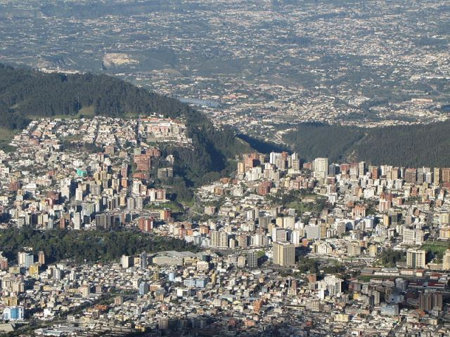
Treating urban wetlands right: Reduce water consumption and harmful run-off
As individuals avoid toxic materials that drain into wetlands
As cities measure, then act to reduce water consumption
Example: Quito, Ecuador
Detailed measurement of water use in 2012-14 with Cities Footprint Project
Aim: cut water footprint by 68% by 2032
Promoting ecological toilets, water-efficient appliances
Quito, Ecuador
Photo: Wikimedia Commons

Slide 20
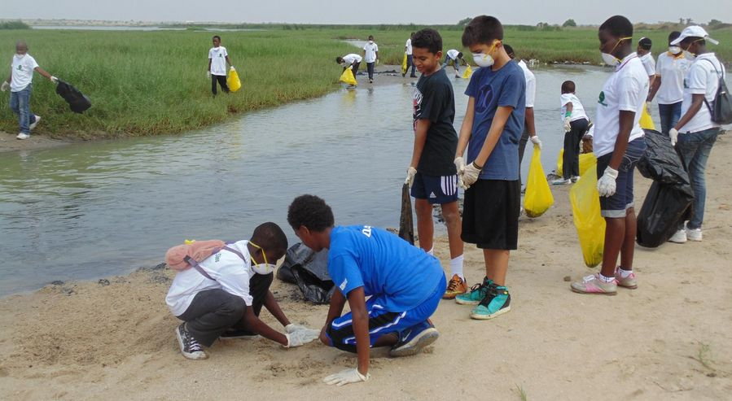
Treating urban wetlands right: Engage youth and community
Join or organize a local wetland clean-up exercise
Organise community based training on wetlands conservation and wise
Example: Bolsa Chica Ecological Reserve, California
356-hectare protected coastal wetland near Los Angeles
Non-profit conservancy holds 2 Public Service Days per month
Volunteeers remove 10 tons of trash and debris every year
Clean-up of a Ramsar Site in Ghana, 2015
Photo: Ramsar Convention WWD Photo Contest

Slide 21
Thank you!
Ramsar Convention on Wetlands
Rue Mauverney 28 | CH-1196 Gland | Switzerland
+41 22 999 01 70 | ramsar@ramsar.org

Slide 22
Sources
For urban population graph, projected percentage of people living in cities in 2050:
UN DESA Population Division: World Urbanization Prospects: The 2014 Revision, p. 25 and p. 1
https://esa.un.org/unpd/wup/Publications/Files/WUP2014-Report.pdf
For current (2016) urban population, annual growth rate and for percentage of people living in cities:
UN DESA Population Division: The World's Cities in 2016 Data Booklet (ST/ESA/ SER.A/392), p.3, p.6 and p. ii
http://www.un.org/en/development/desa/population/publications/pdf/urbanization/the_worlds_cities_in_2016_data_booklet.pdf
For number of mega-cities today and in 2030:same source as above, p.2
For Wetland Extent Index:
Dixon, Lohb, Davidson, Beltramee, Freeman, Walpole: Wetland Extent Index Trends, http://www.ipbes.net/sites/default/files/Metadata_UNEPWCMC_Wetland_Extent_Trend_Index.pdf
For mangrove reduction of storm surges:
Keqi Zhang et al., The role of mangroves in attenuating storm surges, (abstract)
http://www.sciencedirect.com/science/article/pii/S0272771412000674
For damage avoided by wetlands during Hurricane Sandy:
Lloyd’s Tercentenary Research Foundation: Coastal Wetlands and Flood Damage Reduction – Using Risk Industry-based Models to Assess Natural Defenses in the Northeastern USA, p.2
http://www.lloyds.com/~/media/files/lloyds/corporate%20responsibility/ltrf/coastal_wetlands_and_flood_damage_reduction.pdf?id=10.7291/V93X84KH
For global freshwater resources:
World Business Council for Sustainable Development: Water Fact & Trends, 2009, p. 3
http://www.wbcsd.org/Pages/EDocument/EDocumentDetails.aspx?ID=137
For dependence on groundwater in Asia:
Institute for Global Environmental Strategies White Paper, Chapter 7: Groundwater and climate change: no longer the hidden resource, p.160
http://pub.iges.or.jp/modules/envirolib/upload/1565/attach/09_chapter7.pdf
For dependence on groundwater in the European population:
http://ec.europa.eu/environment/water/water-framework/groundwater/resource.htm
http://epp.eurostat.ec.europa.eu/statistics_explained/index.php/Population_and_population_change_statistics
For value of services performed by the Nakivubo Swamp:
Ramsar Convention: Briefing Note 6 - Towards the wise use of urban and peri-urban wetlands, p.6 http://www.ramsar.org/sites/default/files/bn6.pdf
For information on Huangshan City - Xin’an river wetland restoration:
UN Habitat: Urban Development, Biodiversity and Wetland Management – Expert Workshop, p.38
http://mirror.unhabitat.org/downloads/docs/ExpertWorkshopWetlands.pdf
For number of people dependent on the fishing industry:
Food and Agriculture Organization of the U.N.: Fish Trade and Human Nutrition, p.2 http://www.fao.org/cofi/29401-083ff934c3ccfd8576005d8d0c19b04d6.pdf
For the historical loss of wetlands since 1900:
N. Davidson: How much wetland has the world lost? Long-term and recent trends in global wetland area, Marine and Freshwater Research, 2014, 65 ,pp. 934 and 940
http://dx.doi.org/10.1071/MF14173
For information on Accra’s integrated wetland planning:
Conventional on Biodiversity et al., Cities and Biodiversity Outlook- Action and Policy, p. 41 - https://www.cbd.int/doc/health/cbo-action-policy-en.pdf
For information on Wildfowl & Wetlands Trust (WWT) London Wetland Centre:
http://www.wwt.org.uk/wetland-centres/london/
For details of the Stung Treng Ramsar Site community-led conservation efforts:
https://www.worldfishcenter.org/content/integrating-fisheries-management-and-wetland-conservation-stung-treng-ramsar-site-cambodia
For information on carbon and water footprint mapping project in Quito:
Climate and Development Knowledge Network (CDKN): Cities Footprint Project
https://cdkn.org/project/carbon-and-water-footprint-assessments-andean-cities-phase-2/?loclang=en_gb
For Quito water footprint targets:
http://explorer.sustainia.me/cities/planning-for-smaller-co2-and-water-footprints
For general information on Bolsa Chica site:
http://bolsachica.org
For estimate of rubbish cleared from Bolsa Chica site by volunteers:
https://www.egbar.org/wetlands-cleanup

